Slide 1

What are the key drivers behind the increase in the number of E. coli and MSSA infections in England?
Dhyaye, Hodo, Isha, Jenny, Leila, Micheal

Slide 2
Background
Aim: To use population-level data to explain the trends in rates of E coli (BSI) and MSSA bacteraemia.

Slide 3
Project Objectives
Primary Objective:
Explore key drivers in E.coli: To what extent do age, deprivation/ inequalities, and geographical distribution explain trends in the rates of E. coli bacteraemia in England from 2014 to 2024?
Secondary Objectives:
Additional drivers in E.coli: Determine whether antibiotic prescribing patterns and GP appointment trends can explain the observed changes in rates of E. coli bacteraemia.
COVID-19: Assess whether the trends observed during the COVID-19 pandemic reinforce or challenge our findings.
MSSA infections: Evaluate whether the same population-level factors can explain trends in rates of MSSA bacteraemia.

Slide 4
Retrospective observational study using publicly available primary care (NHS trust-level) datasets
Study population: E. coli and MSSA bacteraemia cases in England between 2014 to 2024
Analysis: descriptive statistics, visualizations (descriptive, temporal + spatial),DAG, multivariable regression modelling (+ tests for interactions?), key subgroups?
COVID-19 context: pandemic-specific variables (e.g., lockdown periods, reduced healthcare access) - use temporal analyses + COVID context/healthcare impact/policy interventions to contextualise findings
Compliance with ethical standard:
All datasets anonymised, already publicly available, used the minimum amount of data necessary.

Slide 5
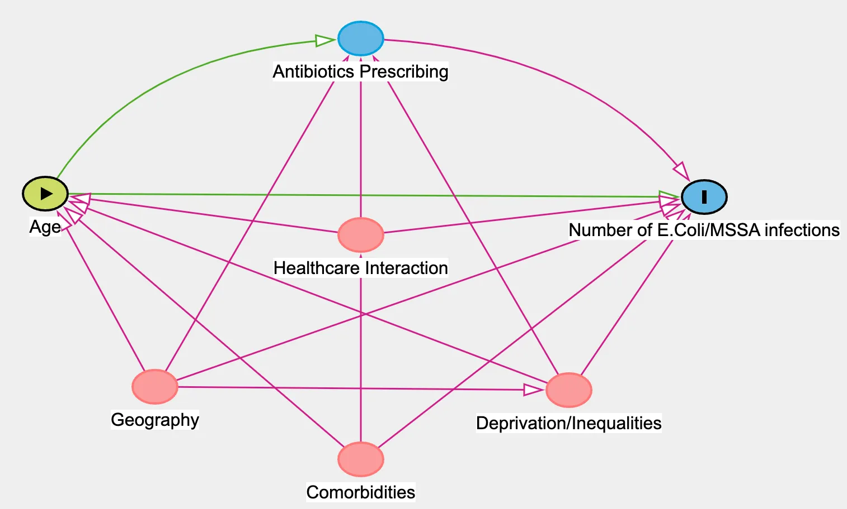
Potential Confounders: DAG

Slide 6
Data Sources
Data collection
Data cleaning, and processing.
Exploratory analysis
Data sources:
ONS (Office of national statistics) , UKHSA (UK Health Security Agency) , ..
Key drivers to explore: age, deprivation + inequality, geographical distribution, prescribing of antibiotics, GP appointments

Slide 7
Analysis:
Data collection
Data cleaning, and processing.
Exploratory analysis
Descriptive analysis
Data visualization
Multivariable regression modelling
Sensitivity analysis?

Slide 8
Preliminary Results
Outline findings clearly – consider the audience

Slide 9
Discuss how identified drivers contribute to trends
STRENGTHS and LIMITATIONS
Acknowledge potential confounding/bias + any limitations of data sources / analysis methods
Highlight actionable insights, such as targeting infection prevention resources to high-risk groups or regions. Link findings to policy initiatives (e.g., addressing healthcare access gaps, tackling antimicrobial resistance).

